Slide 1
PRDA-05
CUSTOMER SHOPPING BEHAVIOUR ANALYSIS
An Interactive Power BI Analysis of Shopping Patterns Across 10 Istanbul Malls (2021–2023)
Created by:-
Ritika Tak
Harsh Raj Singh
Customer shopping data across 10 Istanbul malls • 99,457 transactions • 2021–2023

Slide 2
Project Overview
KEY METRICS
This project examines customer shopping behaviour across 10 malls in Istanbul, focusing on who is buying, what they are buying, and how they are paying.
The aim is to turn the data into useful business insights that can support decisions around customers, products, marketing and payment strategies : rather than simply presenting charts.
252M TL
Total Revenue
99K
Total Orders
99K
Unique Customers
What’s Covered
Shopping patterns by gender and age
Best-selling product categories and the customers buying them
Payment methods and how they vary across categories
Power BI dashboard analysis and key business insights
299K
Total Quantity
2.53K TL
Avg. Order Value

Slide 3
Dataset Overview
The dataset covers customer transactions from 10 shopping malls in Istanbul between 2021 and 2023. Each row represents one purchase, including details about the customer, products purchased, amount paid, payment method and shopping location.
Field | What it means
Gender / Age | Basic customer details
Category | What was bought (8 product types)
Quantity / Price | How many items, and the price per item, in Turkish Lira
Payment method | Cash, Credit Card, or Debit Card
Mall / Date | Where and when the purchase happened
99,457
purchases in total

Slide 4

INTERACTIVE DASHBOARD
The interactive Power BI dashboard allows the analysis to be filtered by gender, age group, category and shopping mall to explore customer behaviour from different perspectives

Slide 5
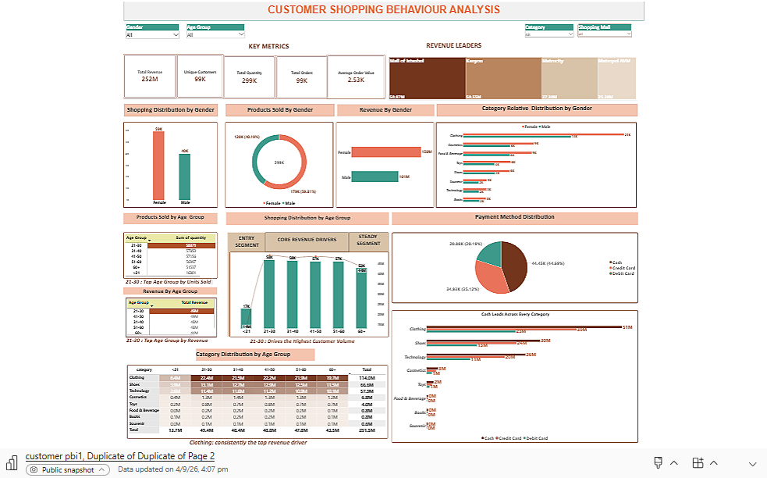

Slide 6

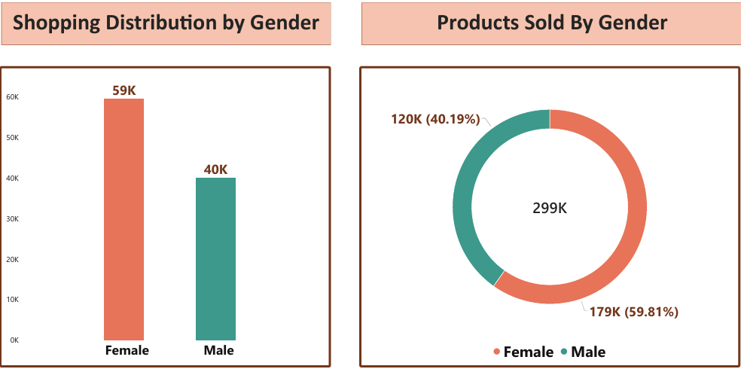
Who's Shopping More?
Q1. How is the shopping distribution according to gender?
Q2. Which gender did we sell more products to?
59.8%
of all orders placed by women
Observation Out of 99,457 total orders, women placed 59,482 (about 60%), compared with 39,975 by men. The same pattern is seen in quantity purchased, with women buying 179K units compared with 120K units by men
Business Insight Female customers are clearly the larger shopping segment across both orders and quantity. This makes them an important audience for customer acquisition and retention, while the male segment presents an opportunity for further growth.
5

Slide 7

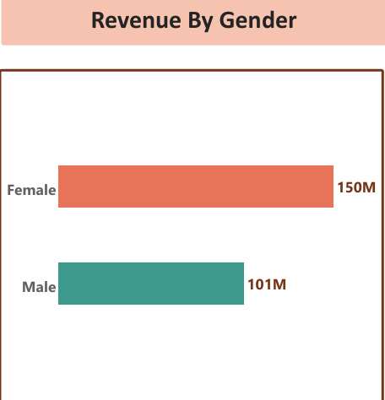
Who's Bringing in More Revenue?
59.6%
Q3. Which gender generated more revenue?
of total revenue from women
Women generated 150.2M TL in revenue compared with 101.3M TL for men, a difference of almost 49M TL. This follows the same overall pattern seen in orders and quantity, with women contributing roughly 60% of the total.
Observation
Business
Insight
Female customers contribute more revenue alongside higher order volume and quantity. This suggests that customer reach and repeat purchases could be important areas to focus on, while the male segment provides an opportunity for further revenue growth.
5

Slide 8
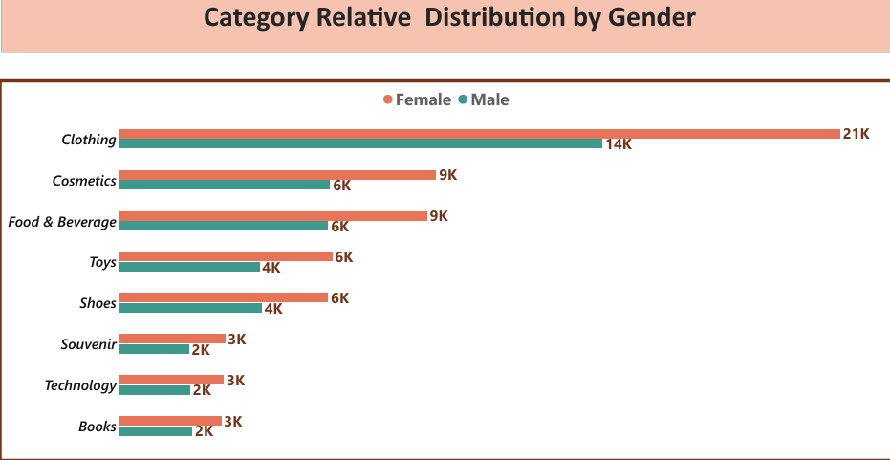
Do Men and Women Buy Different Things?
Q4. Distribution of purchase categories relative to other columns (Gender).
100%
category ranking matches across genders
Observation
Clothing is the leading category for both female and male customers, with 21K units for females and 14K for males. The remaining categories also follow a broadly similar pattern across both genders, although the volumes differ.
Business Insight
The similar category pattern suggests that gender does not significantly change the overall category mix. The main difference is the higher purchase volume from female customers, so the company can maintain a broadly common category strategy while using different marketing approaches to engage each gender.
5

Slide 9
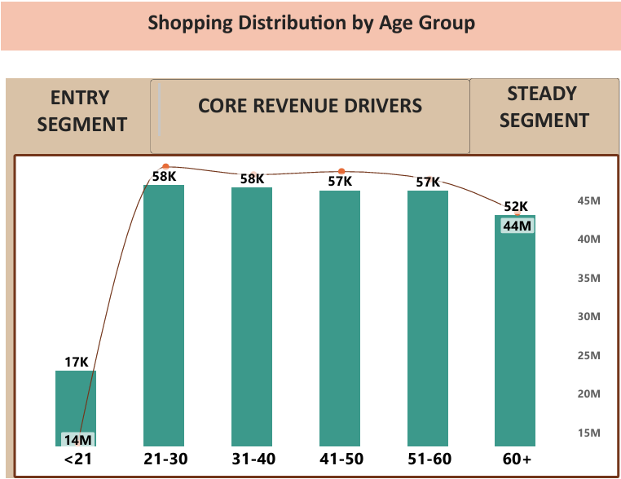
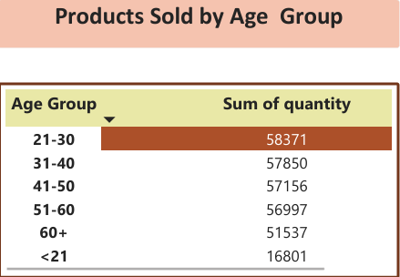
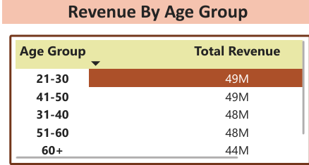
Which Age Groups Shop the Most?
Q5. Shopping distribution by age. Q6. Which age category sold more products? Q7. Which age category generated more revenue?
+2.5%
Demand spread across the 21–60 core
Observation
21–30 comes out just ahead on both items bought (58,371) and revenue (49.4M TL), but the difference is small. The 21–60 age groups show very similar purchase levels, while the under-21 group is clearly lower, with 16,801 items bought and 13.7M TL in revenue.
Business Insight
the results show a fairly balanced customer base across ages 21–60 rather than one dominant age group. A broader campaign targeting this core age range could be more effective, while a separate promotion for the under-21 segment could help increase its contribution.
5

Slide 10
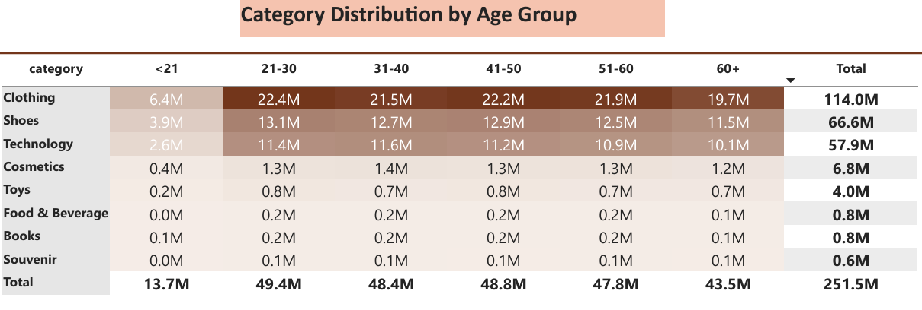
Does Age Change What People Buy?
Q8. Distribution of purchase categories relative to other columns (Age Group).
114 M
Clothing revenue across all ages
Observation
Clothing is the leading category across all age groups, followed by Shoes and Technology. The category ranking is broadly similar across the 21–60 age groups, while the under-21 group records lower revenue across all major categories.
Business Insight
Purchase category patterns are broadly consistent across age groups, with Clothing, Shoes and Technology driving most of the revenue. This suggests the company can maintain focus on these major categories across the 21–60 customer base, while using targeted offers to grow lower-performing categories and the under-21 segment
9

Slide 11
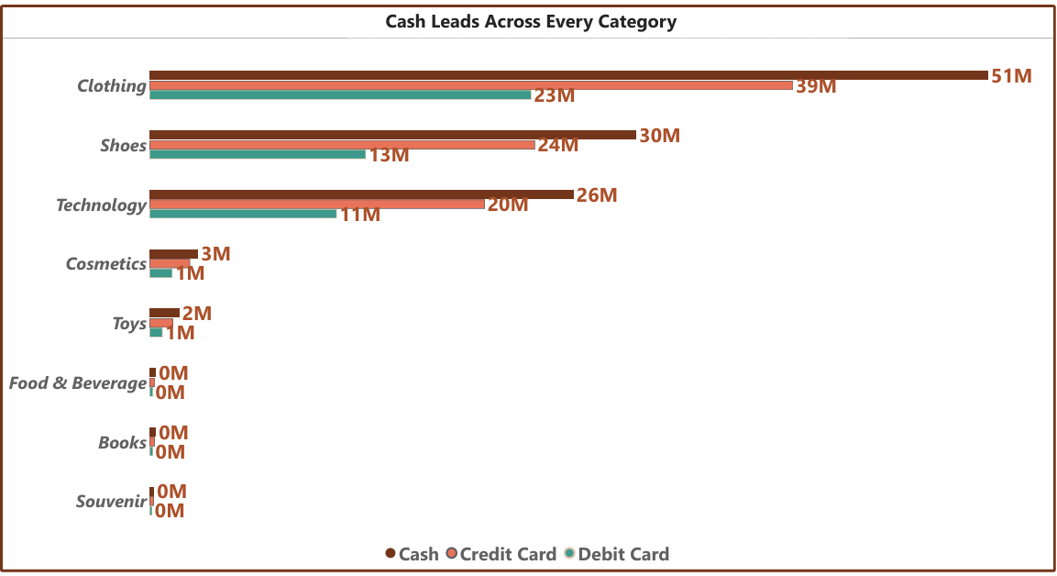
Does Age Change What People Buy?
Q9. Does the payment method have a relation with other columns?
8/8
categories where Cash leads
Observation
Cash comes out on top no matter what category you look at. In Clothing it's 51.3M TL cash versus 39.4M credit and 23.3M debit; Shoes and Technology follow that exact same order.
Business Insight
The Cash > Credit > Debit ordering holds with zero exceptions across 8 independent categories - Cash leads across all product categories, followed by Credit Card and Debit Card. This consistent pattern suggests that payment preferences are broadly similar across categories, so payment initiatives can be considered across the wider customer base rather than category by category.
9

Slide 12
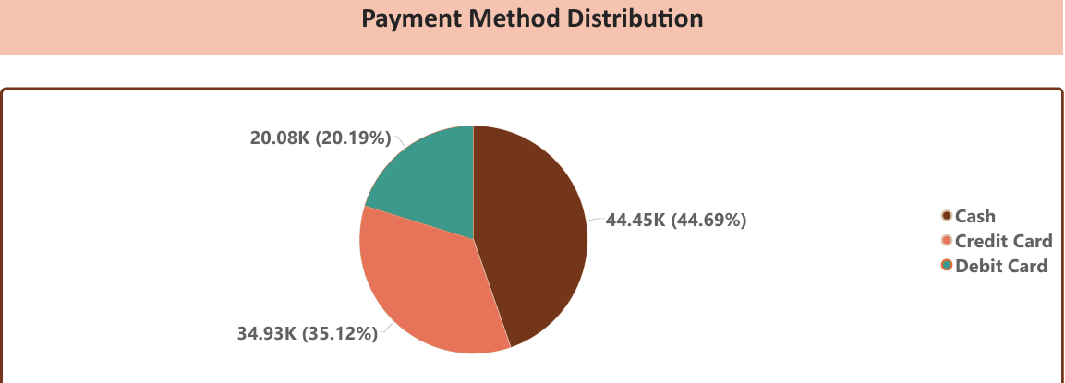
How Do People Pay?
Q10. How is the distribution of the payment method?
55.3%
of transactions already on cards
Observation
Cash is the most common payment method at 44.69% of transactions, followed by Credit Card at 35.12% and Debit Card at 20.19%. Together, card payments account for 55.31% of transactions.
Business Insight
Card payments already make up the majority of transactions, so the focus should not be on introducing digital payments but on gradually encouraging cash users to shift towards card payments through simple incentives or offers.
11

Slide 13
What This Data Is Really Telling Us
Women lead in orders, quantity and revenue, contributing around 60% of the overall business across these measures.
Customers aged 21–50 form the strongest-performing age groups, while the under-21 segment is the clear outlier with much lower purchase volume and revenue.
Clothing is the largest revenue contributor by a wide margin, followed by Shoes and Technology.
The category mix is broadly similar across age groups and genders, with differences mainly appearing in overall purchase volumes rather than the leading categories.
Cash is the most-used payment method, although card payments combined account for the majority of transactions. Cash also leads across the product categories shown.
Mall of Istanbul and Kanyon are the top revenue-generating malls, performing clearly ahead of the other malls in the dashboard.
12

Slide 14
What We'd Suggest Doing About It
It contributes nearly half of total revenue, so it should remain a key focus while testing ways to grow smaller categories.
1
KEEP CLOTHING AS A PRIORITY
These groups show similar purchase levels, making a broader campaign more practical than highly segmented campaigns. The under-21 group can be addressed separately.
2
TARGET THE 21–50 AGE GROUPS TOGETHER
Women contribute around 60% of orders and revenue, while men still represent about 40%. Both segments are worth targeting with different messaging.
3
CONTINUE TARGETING BOTH GENDERS
Together, these categories contribute around 72% of revenue, making them suitable for bundle or cross-selling opportunities.
4
EXPLORE CLOTHING + SHOES BUNDLES
Cards already account for the majority of transactions. Small incentives could encourage some cash users to shift toward card payments, particularly at lower-performing malls.
5
TEST DIGITAL-PAYMENT INCENTIVES
LEARN FROM THE TOP-PERFORMING MALLS
Mall of Istanbul and Kanyon lead in revenue. Understanding what drives their performance could help identify practices worth testing at other malls.
6
12

Slide 15
CONCLUSION
Looking across everything — who’s buying, what they’re buying, and how they’re paying — the same picture keeps showing up: women aged roughly 21 to 50 are among the strongest customer groups, Clothing carries most of the revenue, and card payments already account for the majority of transactions. These findings provide a practical basis for deciding where to focus marketing, inventory and payment strategy going forward.
THANKYOU

